Slide 1

Lending Club Case Study - Identifying Risky Borrowers to Optimize Lending Strategies
Akash Apoorv Yadav
Anoop Oduvil

Slide 2

Contents
Business Objectives & Analysis Focus
Analysis Approach
Dataset Overview
EDA
Key Findings
Recommendations

Slide 3
Business Objectives & Analysis Focus
Company
The largest online loan marketplace offering personal loans, business loans, and financing for medical procedures.
Borrowers benefit from easy access to lower-interest loans through a fast online interface.
Problem:
Credit Loss: Lending to risky applicants causes the largest financial loss (credit loss), where defaulters are customers labeled as ‘charged-off’.
Analysis Goal:
Identify Risky Borrowers: Use Exploratory Data Analysis (EDA) to identify patterns and driver variables that indicate the likelihood of loan default.
Business Impact: By identifying risky applicants, the company can reduce loan amounts, deny loans, or adjust interest rates to mitigate financial loss.
Objective:
Understand the driving factors behind loan default and use this knowledge for better portfolio and risk assessment.

Slide 4
Analysis Approach
EDA Techniques
Data Cleaning & filtering:
Identified key consumer and loan attributes
Removed insignificant columns (e.g., null and non-unique values)
Standardized values for easier analysis
Data Analysis:
Univariate Analysis: Examined individual variable distributions.
Bivariate Analysis: Investigated relationships between variables and loan status.
Segmented Analysis: Analyzed insights across consumer demographics and loan statuses
Tools
Python: Utilizing libraries such as Pandas, Seaborn, and Matplotlib
Insights and Recommendations

Slide 5
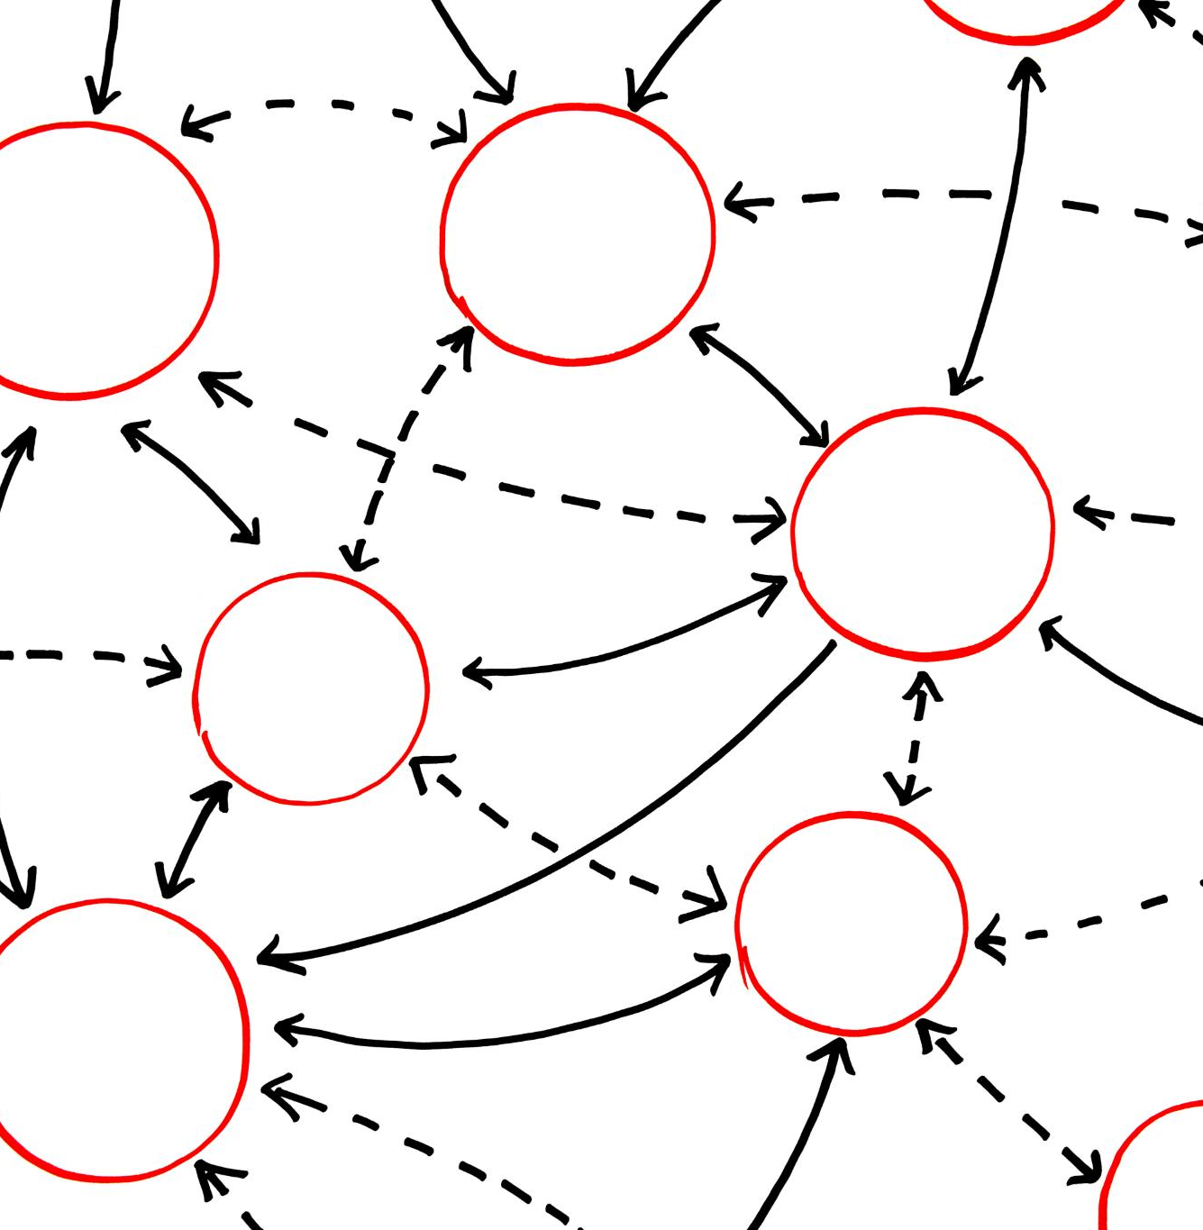
Dataset Overview
Scope: 39,717 records and 111 variables.
Key Features:
Consumer Attributes: home ownership, annual income, employment duration etc
Loan Attributes: Loan Amount, Term, Interest rate, Purpose of the loan etc.
Target Variable: Loan Status (Charged off vs fully paid)
Notes:
The data set consists of 39717 rows and 111 columns in a csv format. The values are a mix of categorical, numerical and date formats which needs to be cleaned and analysed. The intention is to find the relationship between the loan status that indicates whether a loan was fully paid or defaulted in the past. Based on this, we have to identify the risk factors while a new loan is approved

Slide 6
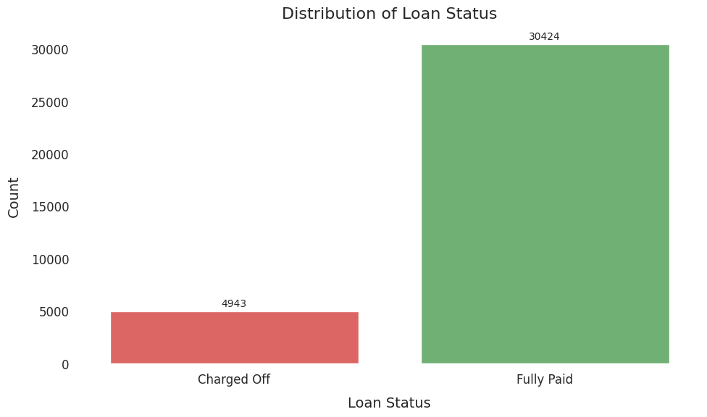
Big Picture: How Loans Are Performing
About 13.98% of the total loans are defaulted or charged-off on average.
To pinpoint key risk factors, we'll focus on categories where the default rate goes over 20%. In particular, we'll take a closer look at variables that lead to a 16.78% or higher jump in the proportion of charged-off loans.

Slide 7
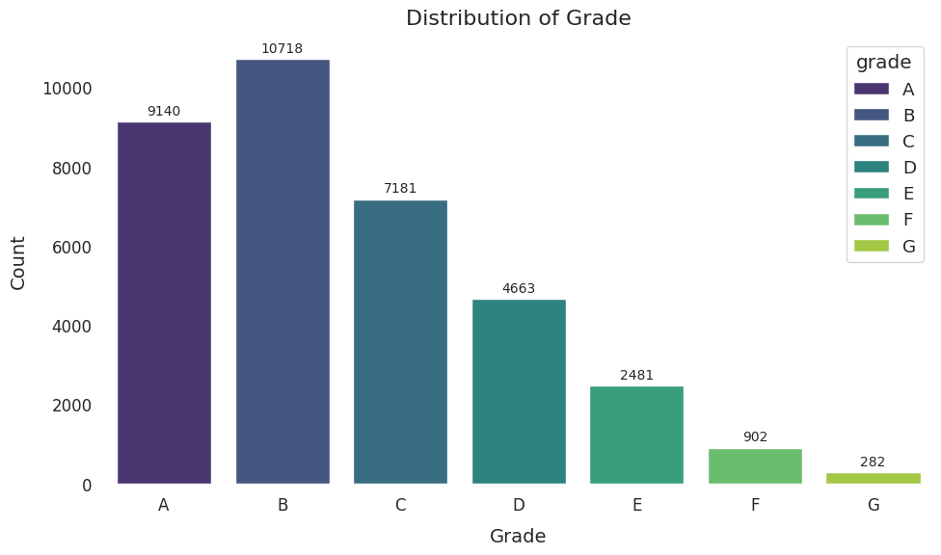
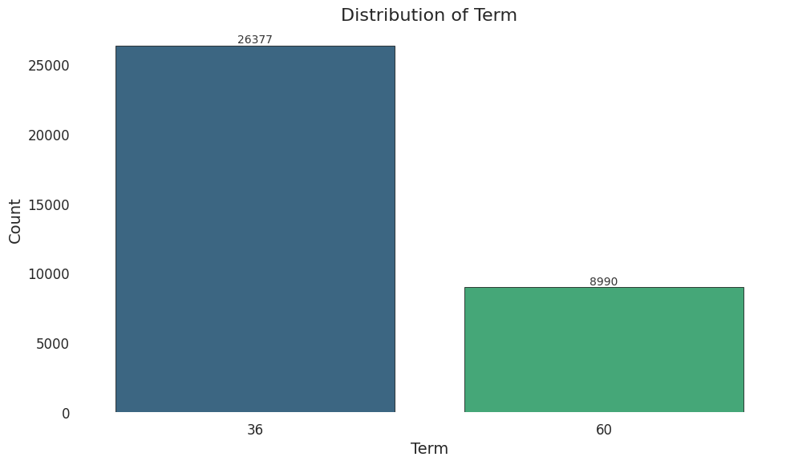
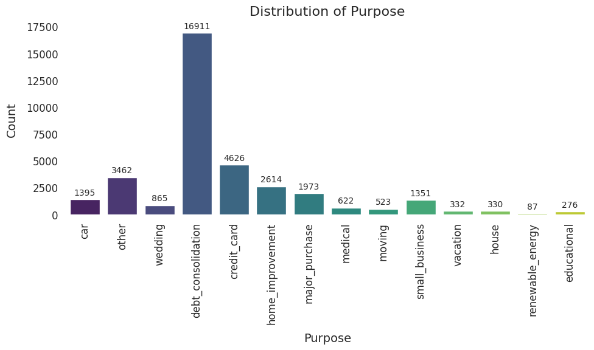
Digging Into Loan Patterns
56 % of loans under highest grade, with low interest -> more sales
75% of short term loans, ensuring faster recovery
RISK!! More loans for debt consolidation

Slide 8
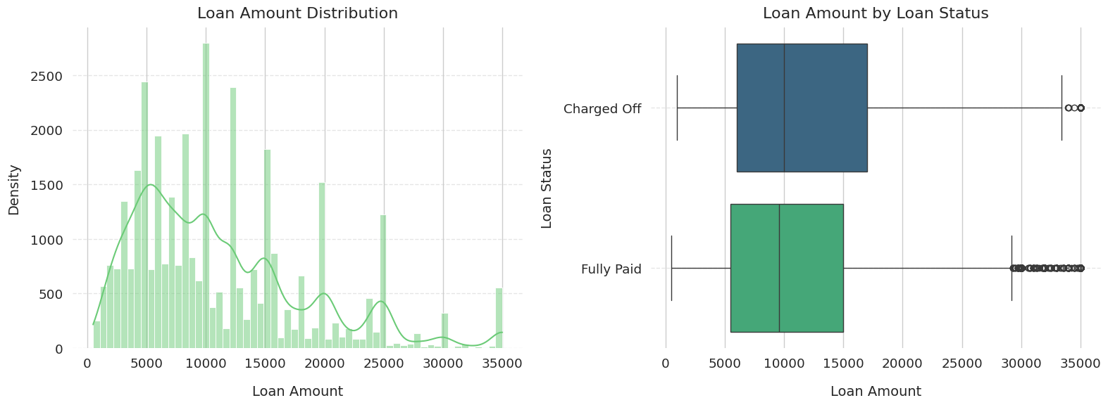
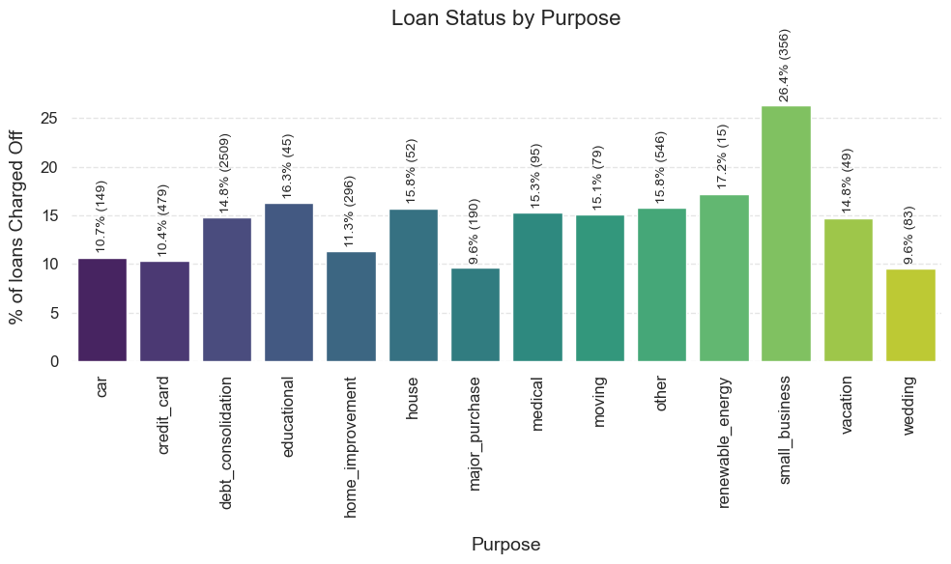
Default Risk - Loan Amount and Purpose
Loan Distribution:
Most loans are between $5,000 and $15,000
Loans >$20,000 are less frequent
Default Risk:
Loans between $20,000–$35,000 show a higher likelihood of being charged-off, likely due to investment or business use.
As seen in Illustration – 2, around 26.5% of loans taken for the purpose of “Small business” has been defaulted

Slide 9
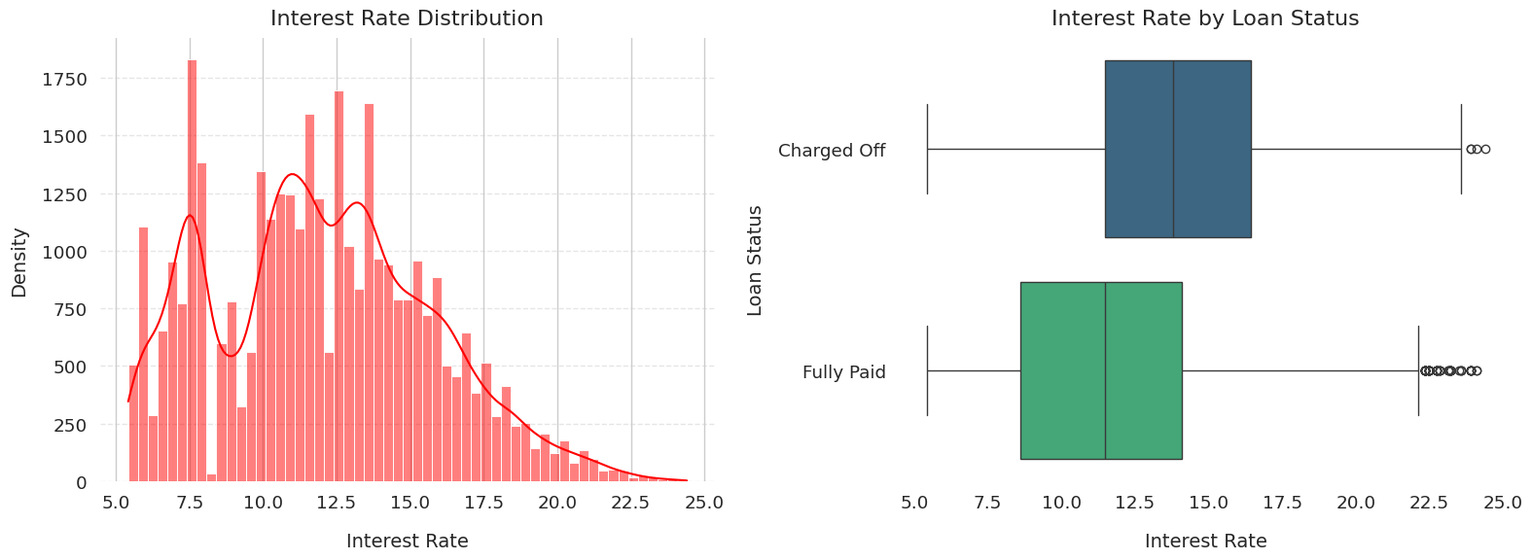
Default Risk - Interest Rate
Loan Distribution:
The interest rate on loans ranges from 5.42% to 24.4%, with an average of 11.8%.
Charged-off loans tend to have higher interest rates compared to fully paid loans
Notes:
This is expected, as lenders typically charge higher rates to compensate for the increased risk associated with borrowers who are more likely to default. Further analysis is needed to explore this relationship in more detail.

Slide 10
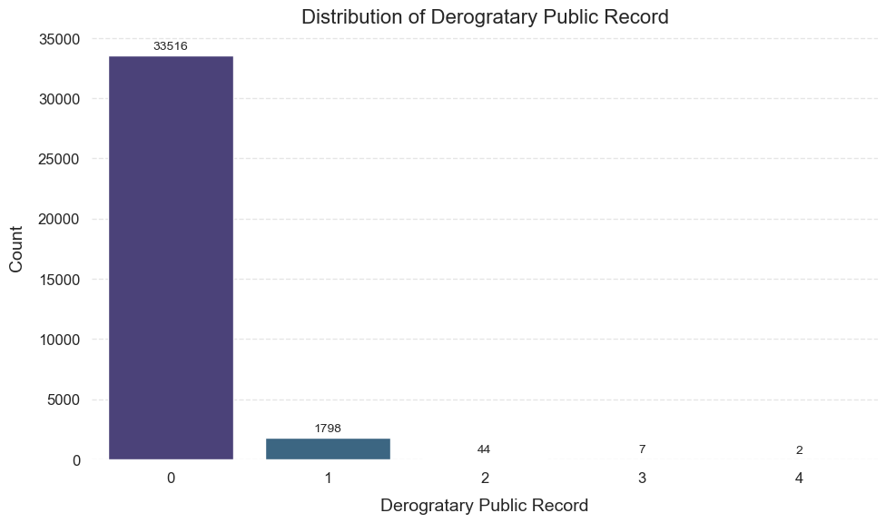
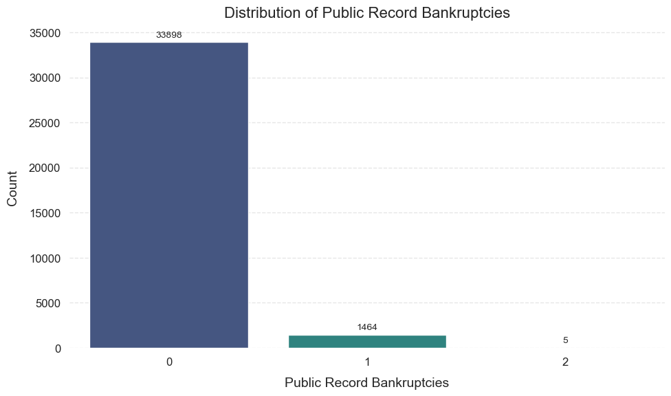
Default Risk by Customer Records
Loan Distribution
Around 95% of the loans were given to the customers with 0 Public derogatory records or public bankruptcy records
Default Risk:
Records show Charged-off loans > 20% for such customers
This should be considered strictly while disbursing the loan

Slide 11
Customer income Trends

Slide 12
Customer Employment Trends

Slide 13
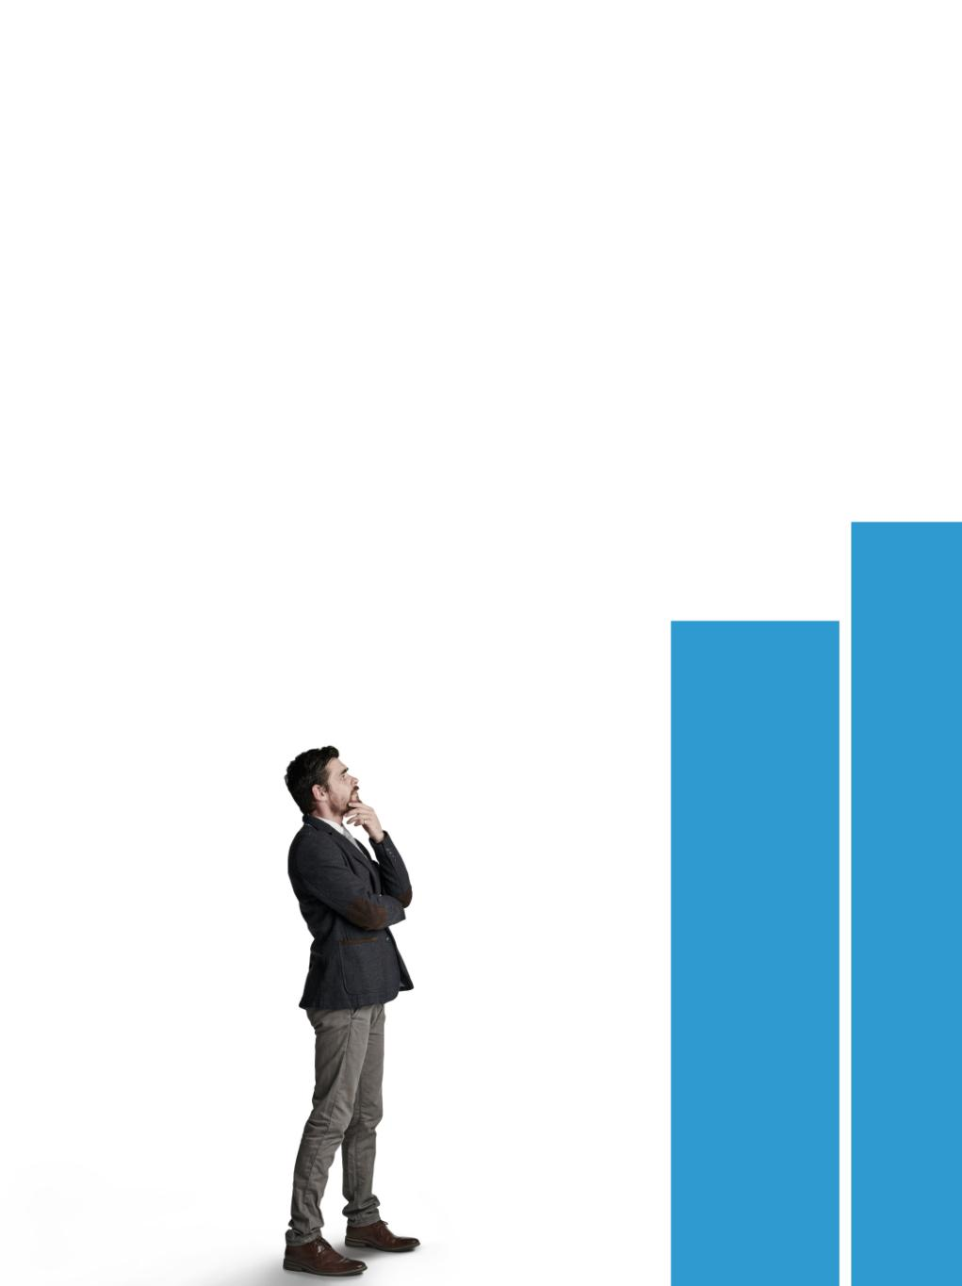
Key Findings From the Analysis
Risks for loan defaulting based on the Loan Parameters:
Higher loan amounts tend to have higher default rates, especially for the amounts above $20K
Higher the term, chances of being defaulted are high
Loans taken for the debt consolidation has the history of being defaulted
Risks for loan defaulting based on the Customer parameters:
Customers who are on RENT and taking loan for Debt Consolidation seems to be defaulting the loan at a higher rate
Enquiry on public bankruptcy of the customer would be highly beneficial since this seem to have direct connection with the chances of being defaulted

Slide 14
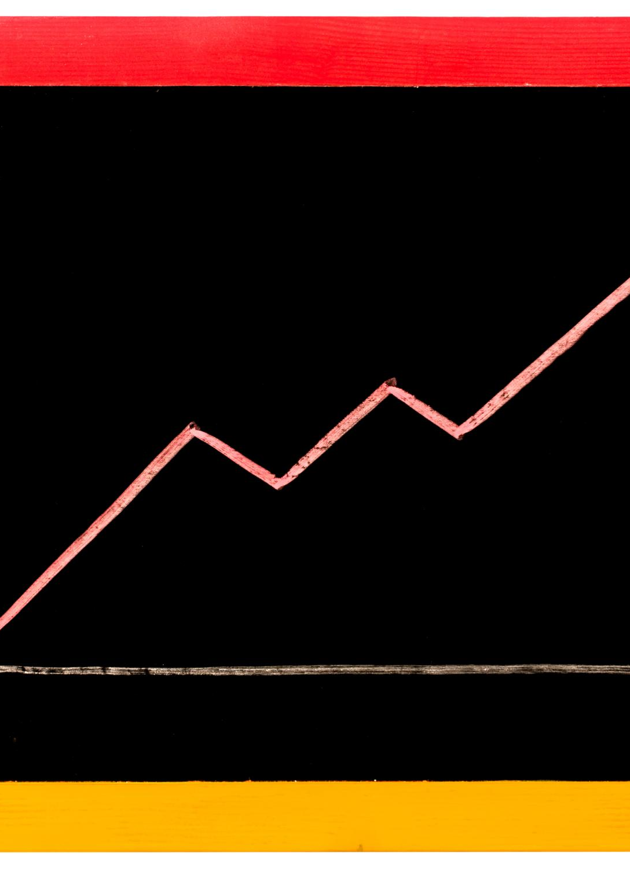
Implications for Lenders
Informed Lending Practices
These findings can guide lenders in refining their lending practices to minimize risk and improve outcomes.
Understanding Risk Factors
By analyzing risk factors associated with defaults, lenders can enhance their decision-making processes and strategies.
Policy Development
Policymakers can use these insights to create effective policies that promote responsible lending and financial stability.

Slide 15

Recommendations for Further Analysis

Slide 16
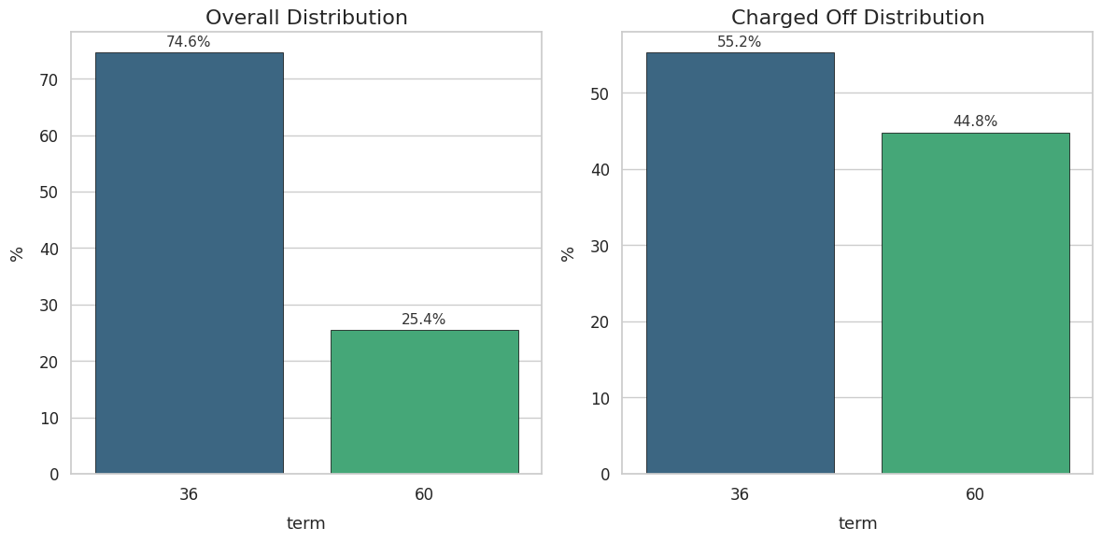
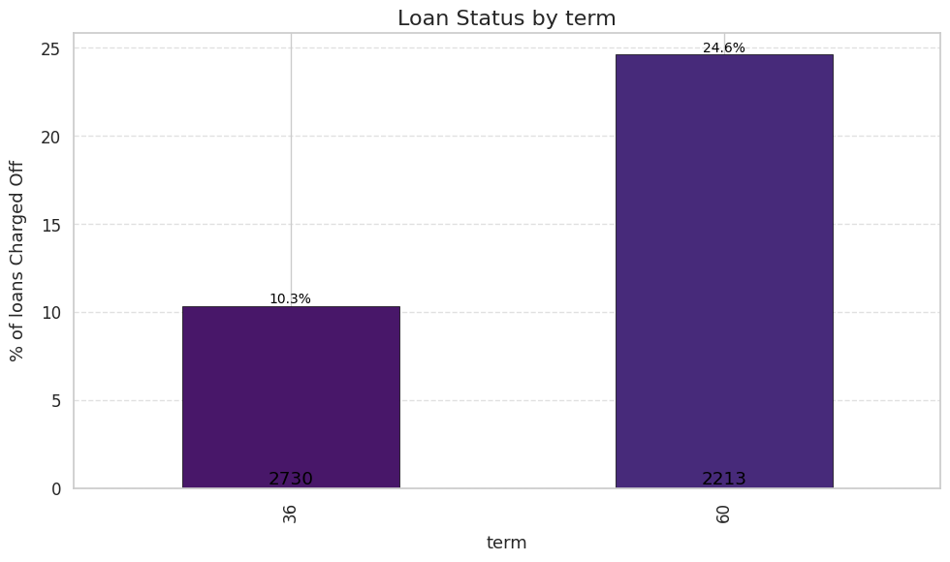
Loan Term period Trend
Loan Distribution:
Two available terms: 36 months and 60 months
Majority of loans approved for 36 months
Default Risk:
Loans with 60-month term have a 24.6% charge-off rate, indicating higher default risk
EDA Techniques used:
Univariate analysis to find the Loan distribution (Pic1)
Bi Variate analysis to find the relation between loan term and loan status (Pic2)

Slide 17

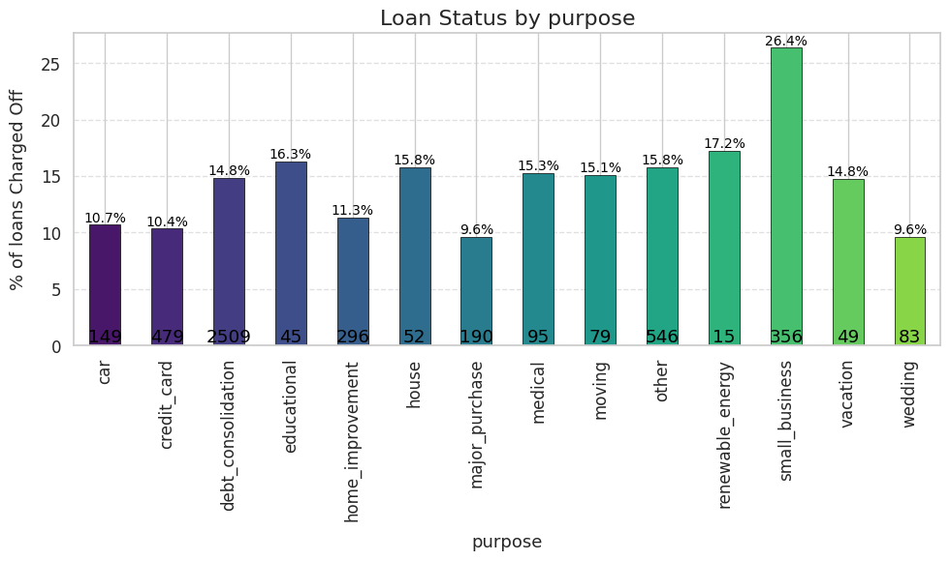
Loan Purpose Trend
Distribution:
47% of all loans are for Debt Consolidation, making it the primary purpose for loan origination
Trends:
Debt Consolidation represents a significant portion of the loan portfolio, influencing both origination and charge-offs
Default Risk:
26% of Debt Consolidation loans are charged off, indicating a higher risk of default for loans taken for this purpose

